Slide 1
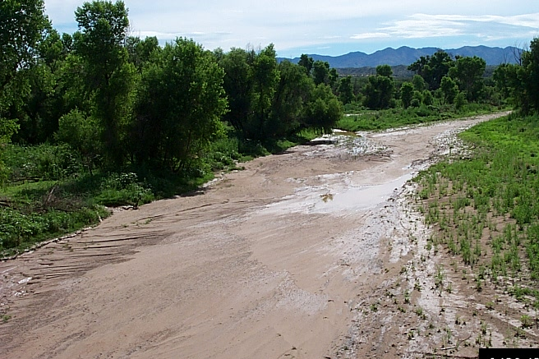


Using Geophysical and GIS Methods to Develop a Hydrogeologic Framework for the Upper Santa Cruz River Basin
Kyle Withers
University of Arizona
Acknowledgements:
James Callegary
USGS
Space Grant Symposium
April 18, 2009

Slide 2
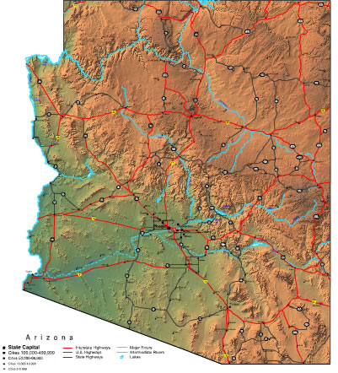
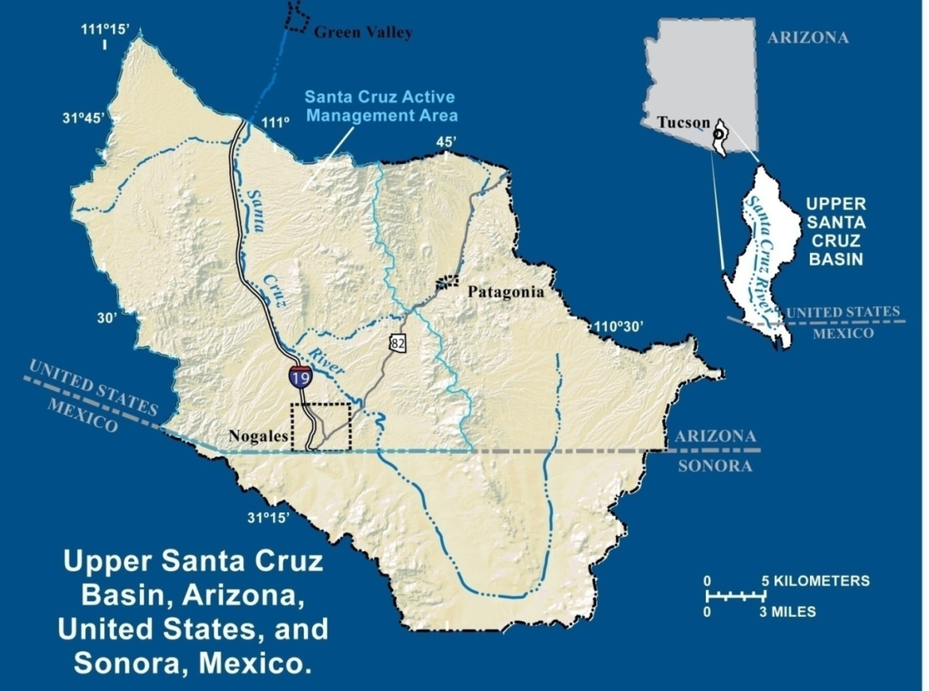
Study Area and Considerations
Upper Santa Cruz Basin
Surface water is scarce
Population is growing
Need to understand hydrogeology of subsurface to understand temporal and spatial variability of groundwater

Slide 3
Goals and Methods
Develop an understanding of hydrologically significant spatial variations in alluvium and rock in the basin
Use techniques of geophysics (electromagnetic and magnetic) to describe and quantify the hydrogeologic framework
Estimate depth to bedrock and variations in the porosity of alluvium that effect movement of groundwater

Slide 4
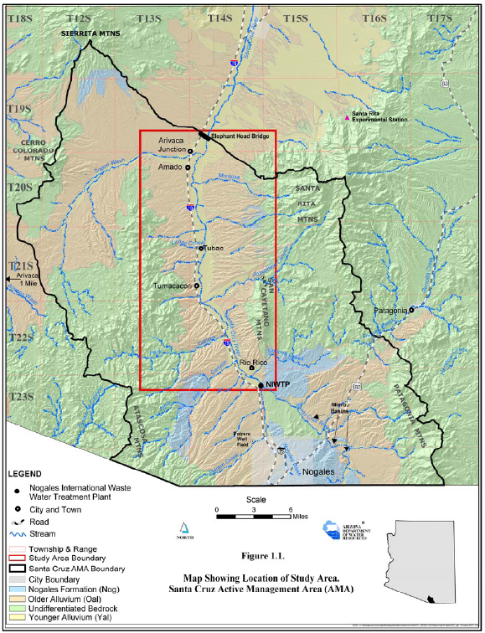
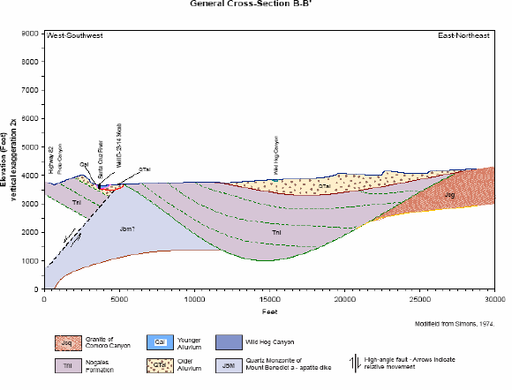
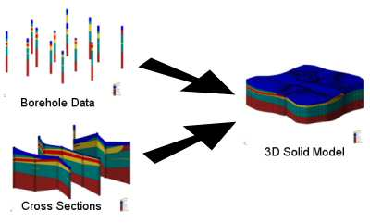
Development of a Hydrogeologic Framework Model
Geologic mapping
Borehole data (observations, core sent for laboratory measurements, geophysical logs)
Surface and airborne geophysics
Forward and inverse modeling of geophysical data
Combine to develop 2-D geologic cross-sections
3-D interpolation to Solid Model

Slide 5
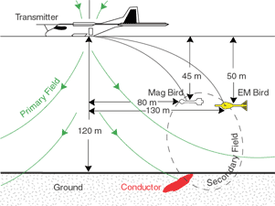
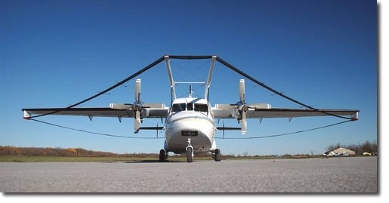
Data
Airborne surveys were flown to collect electromagnetic and magnetic data
GeoTEM: digital time-domain electromagnetic system operated by Fugro Airborne Surveys
http://www.fugroairborne.com/service/geotem.php
http://www.fugroairborne.com/service/geotem_system_specs.php

Slide 6
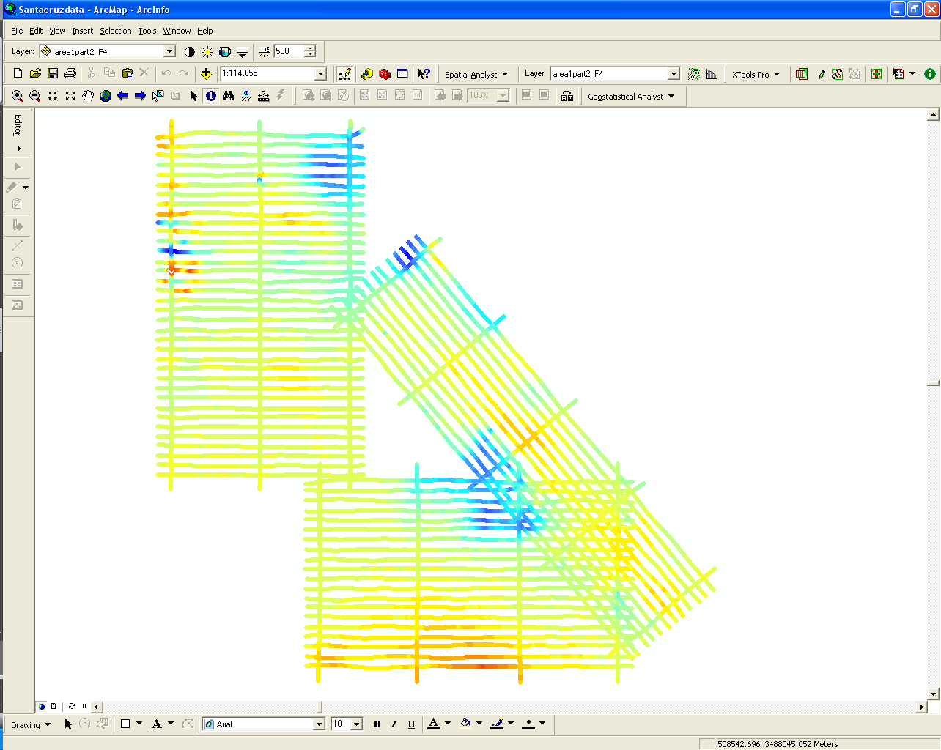
SOFTWARE
ArcMap: software used to develop geographic information systems (GIS) for visualizing, managing, creating, and analyzing geographic data.

Slide 7
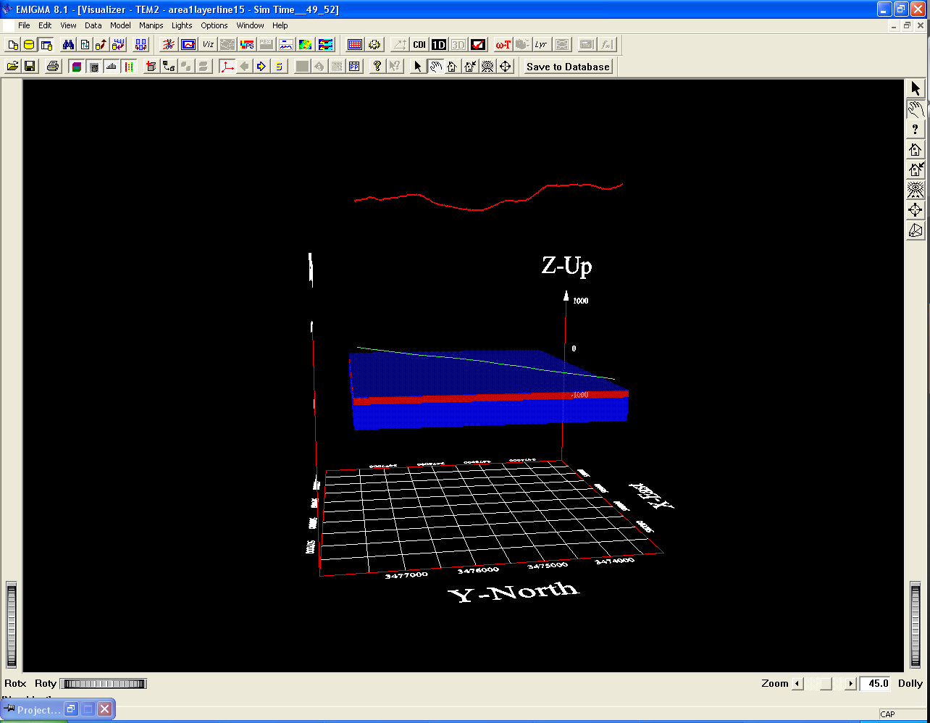
Programs
Emigma V8.1: Numerical solutions for electromagnetic, gravity, magnetic, and other applications integrating data processing, simulation, inversion and imaging software as well as other associated tools.

Slide 8
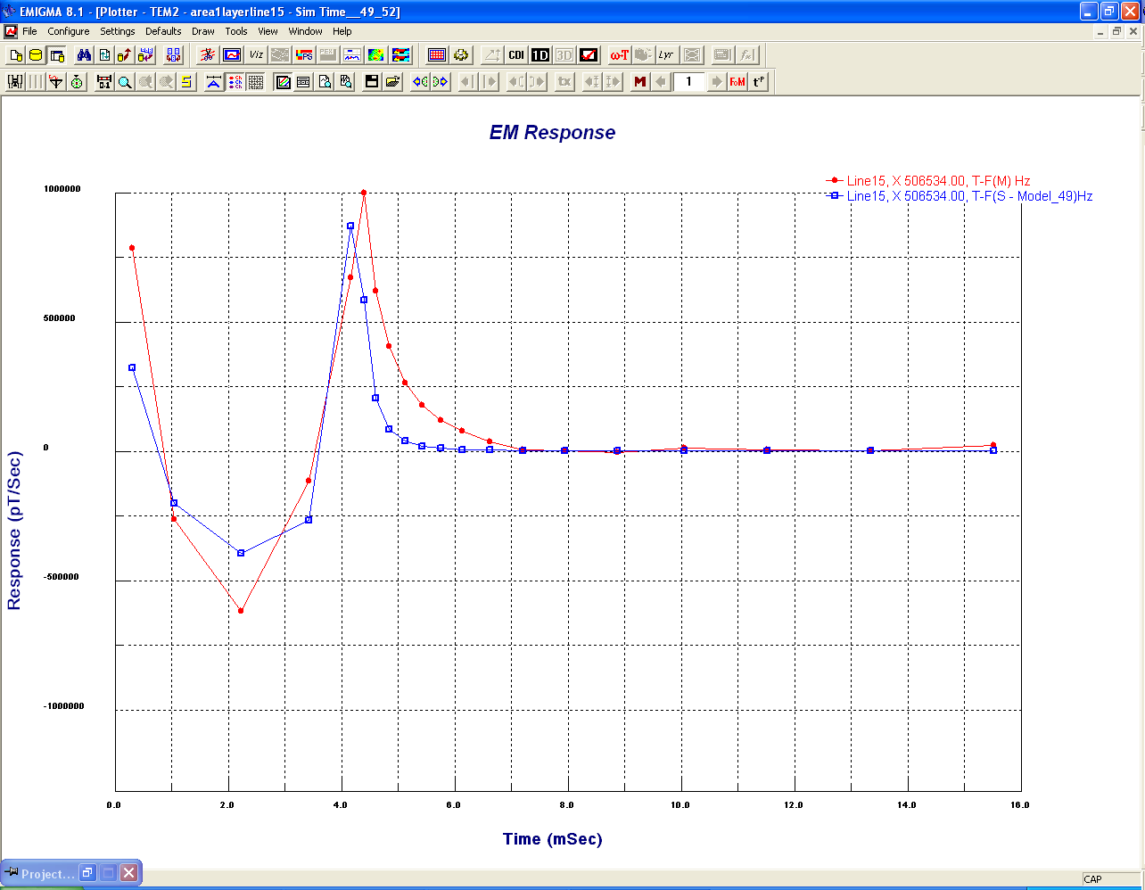
Analysis
Forward Modeling: build physical model of system (e.g. 3D below-ground spatial distribution of electrical conductivity)
Calculate numerically the propagation of electromagnetic fields
Simulate instrument output (dB/dt)

Slide 9
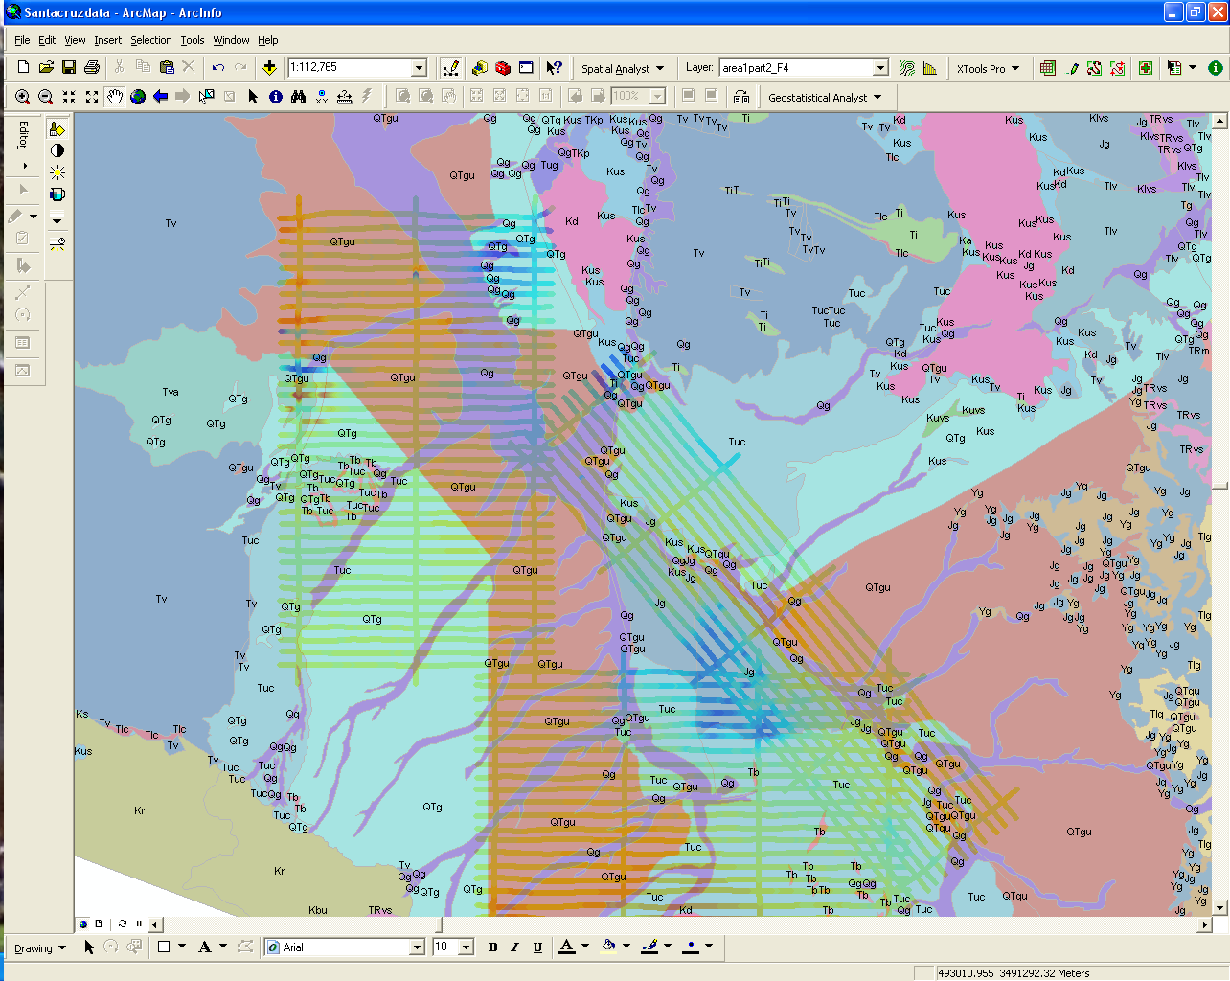
Analysis
Inverse Modeling: derive physical model from observations/measurements
Run forward model numerous times varying layer thickness and electrical conductivity while minimizing the difference between simulated and observed values
Weakness: solutions are nonunique
Compare and constrain with measured data to arrive at plausible model

Slide 10
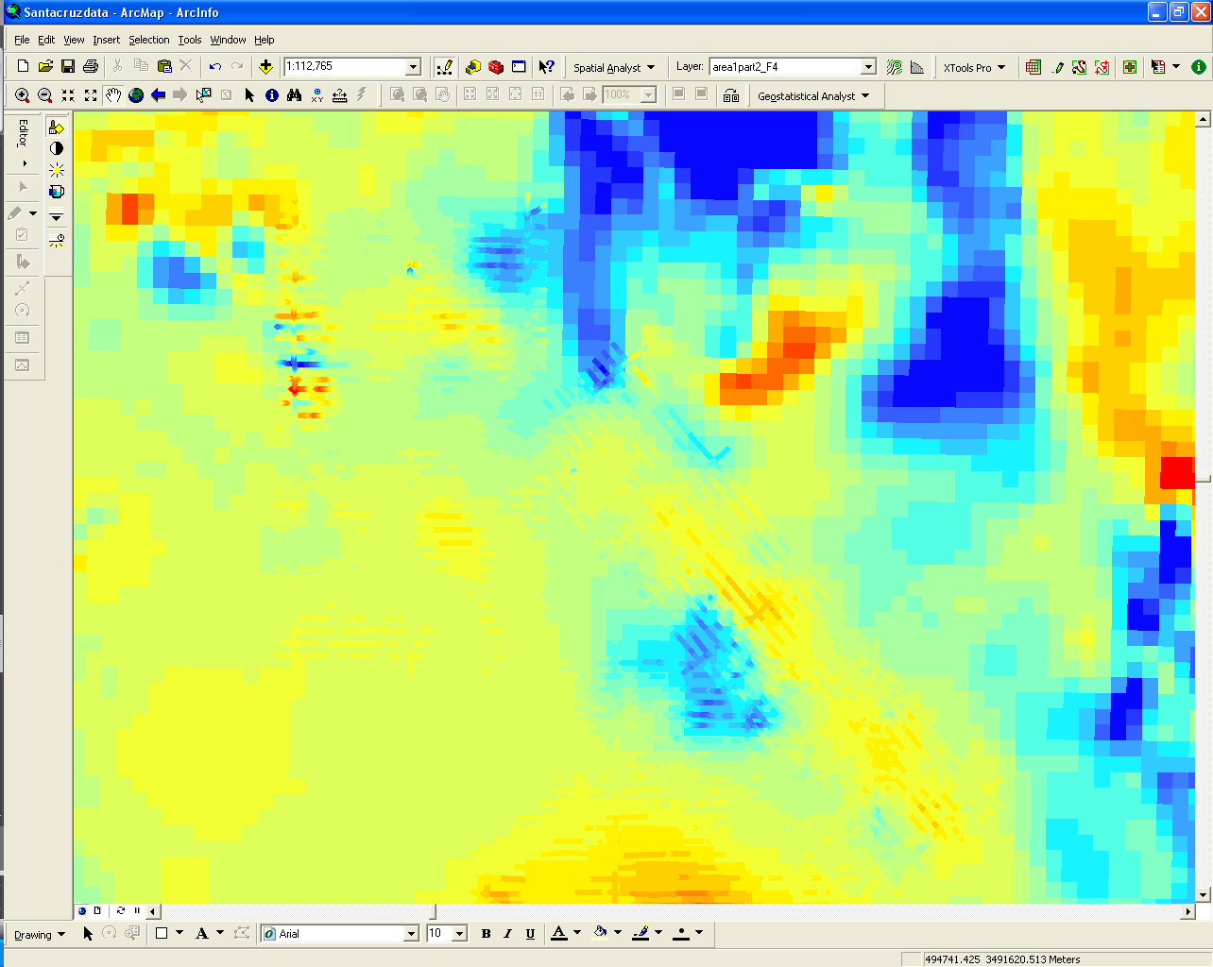
Results
Preliminary results indicate that simple models of the subsurface capture first order variations in electrical properties
Magnetic data measured during TEM flights correspond well with aeromagnetic map for state (Sweeney, R.E., and Hill, P.L., 2001. Arizona Aeromagnetic and Gravity Maps and Data: A Web Site for Distribution of Data: U.S. Geological Survey Open-File Report 01-0081. )

Slide 11
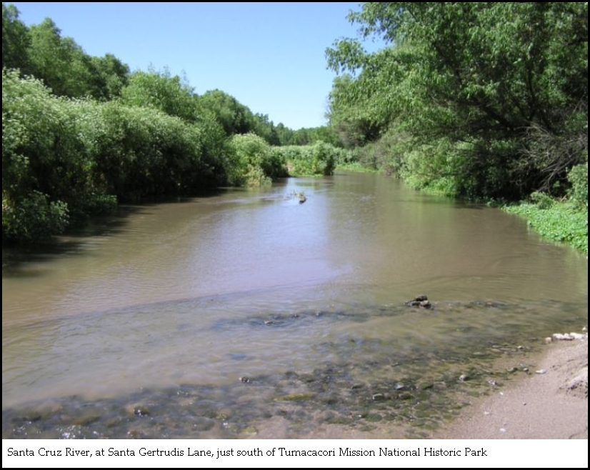
Questions?

